Slide 1
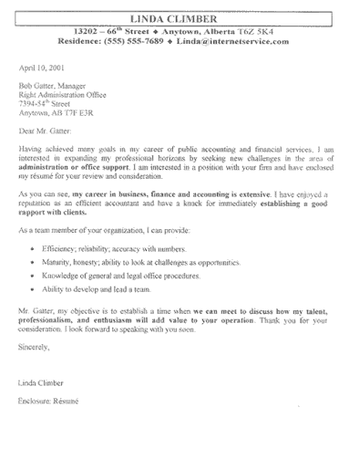
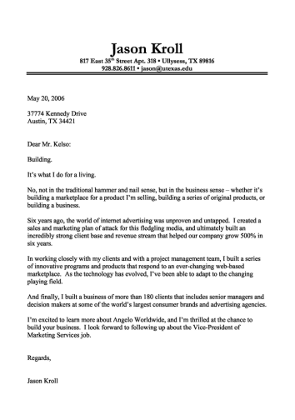
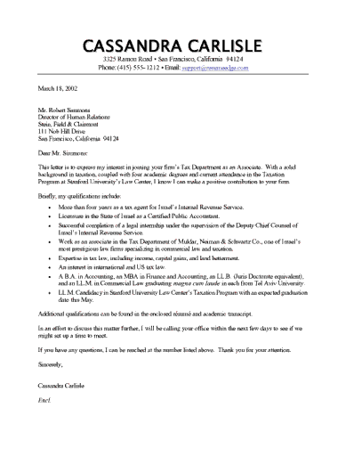
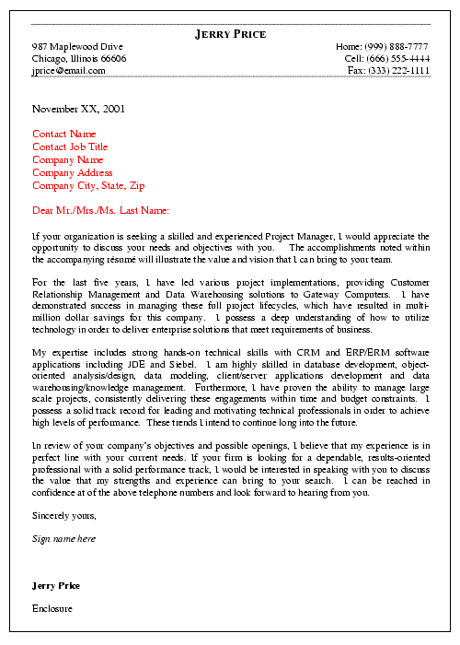

How to Write a Cover Letter
Revised April 2010

Slide 2
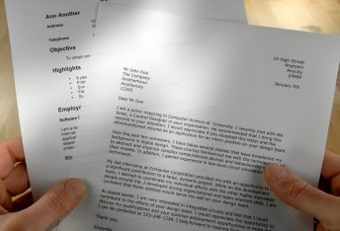
What is a Cover Letter?
A cover letter is a letter sent alongside your resume to introduce yourself, explain why you are sending in your resume, and provide more information about yourself.

Slide 3

What’s the Point of a Cover Letter?
Introduce yourself
  Cover letters should carry a message about you
Get you noticed
  Project the desired image of you or your business
Convey special information
Highlight accomplishments
Get employers, award judges and scholarship committees to read your resume

Slide 4

Stylish Cover Letters
Block Style
  All lines start on the left side of the margin
  No indentations
Modified Block Style
  Uses indentations
  Each paragraph is indented, as well as the beginning information and the close

Slide 5

Helpful Hints:
Be assertive – the first 20 words are the most important
Value to employer – tell your story in relation to how you can be of value to the employer
Use simple and direct language and grammar
Let your letter reflect your individuality
Send it to someone by name
Get it right – spell recipient’s name right
Be friendly, not pushy
Target your letter – tell your reasons for sending the letter, for example, desiring an interview

Slide 6

Don’t Forget to…
Use good grammar and correct spelling
Do not use slang
Be brief, but cover the subject
Stick to the point of the letter
Proofread, proofread, proofread!
Ask for help if you need it
Strive for neatness and personality

Slide 7

You Should Include…
Your address and the date the letter was written
The name and address of the person to whom the letter is being sent
A salutation (Dear ____:)
The body of the letter
A complimentary close and signature
A title of respect, such as Dr., Mr., or Ms.
A return address and zip code
Can also include reference initials, enclosure notifications (such as your resume), copy and postscript

Slide 8
The Body of the Letter
Your street address
Your city, state, zip code
Month, Day, Year
Mr./Ms./Dr. Name
Title
Name of company/organization
Company address
City, State, Zip code
Dear Mr./Ms./Dr. Last Name:
Paragraph 1: Answers “Why am I writing?”
  Identify the position and the company
  Indicate how you learned about the position
  Request the employer’s consideration
  Introduce basic information about yourself
Paragraph 2: Answers “Who am I, and why should you hire me?”
  Contain a brief summary of your personal data and work experience.
  Relate your skills, experiences, and qualities that would benefit you in this position
Paragraph 3: Answers “What is my next step?”
  Refer the reader to your enclosed resume
  Reiterate your interest in the position
  Specify how you will follow up
Sincerely,
Your signature
Your name
Telephone number
Email address
First paragraph – reason for writing
Second paragraph – point out qualifications
Third paragraph – call attention to resume, reiterate interest

